Slide 1
19th Annual IEEE Ottawa Robotics Competition 19e Compétition annuelle de robotique d’Ottawa d’IEEE
Micro:Bit Challenge Workshop
March 3, 2022

Slide 2
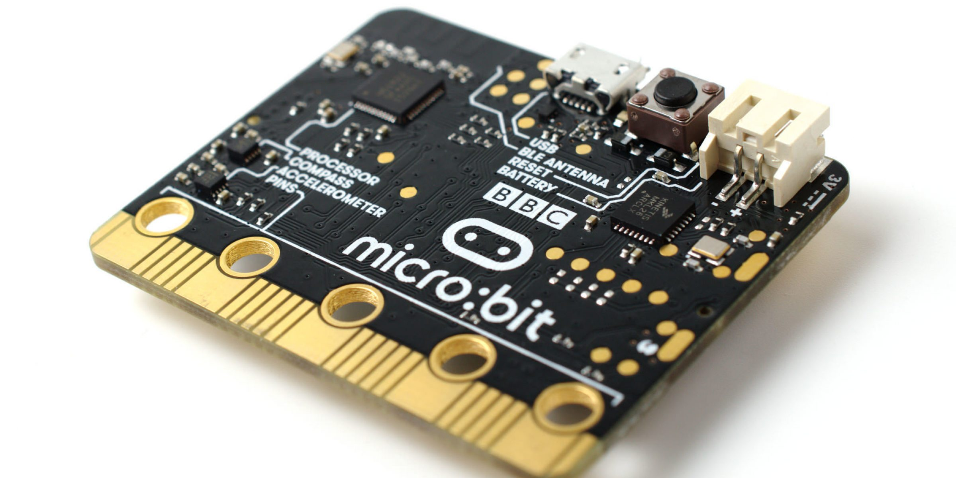
About Micro:bit
Microcontroller developed by the BBC
Designed to be easy and fun to program
Tutorials: https://microbit.org/
Documentation: https://makecode.microbit.org/docs

Slide 3
DFRobot Maqueen Kit
Kit that includes:
Wheels and roller (movement)
Ultrasonic sensor (distance detection)
Infrared sensors (black/white line detection)
Various coloured LEDs
Micro:bit commands the kit’s movement and is placed behind the ultrasonic sensor (LED side facing the front)

Slide 4
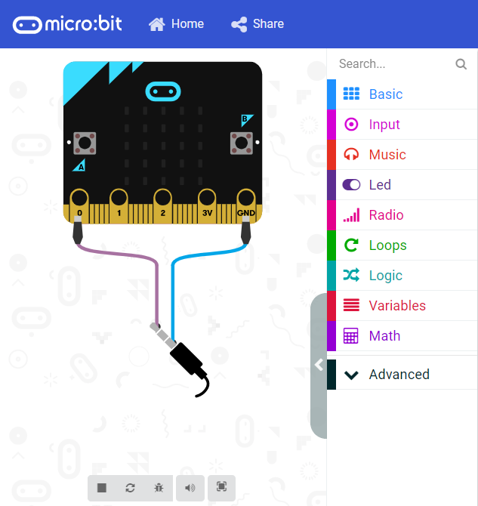
Micro:bit Simulator
Online
https://makecode.microbit.org/
Microsoft Store
https://www.microsoft.com/en-ca/p/makecode-for-micro-bit/9pjc7sv48lcx?activetab=pivot:overviewtab
iOS or Android in respective App Stores (only recommended on large tablets)
Notes:
Physical kit is optional
Only code will be submitted and tested on simulator

Slide 5
Programming
Coding is done here: https://makecode.microbit.org/
Can be programmed in scratch blocks, javascript or python
Students can save the code online or export it
Code can be downloaded straight to the micro:bit or drag and dropped onto it

Slide 6
Micro:bit Classroom
Online classroom environment
Can watch students code live
https://classroom.microbit.org/

Slide 7
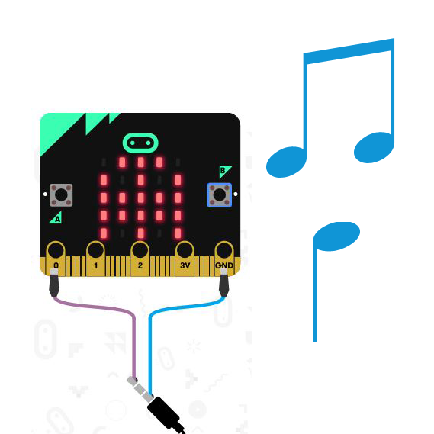
Mix:Tape
Your task:
Create a music player with songs and LED displays to help people stay entertained

Slide 8
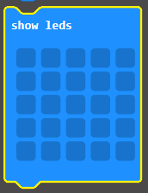
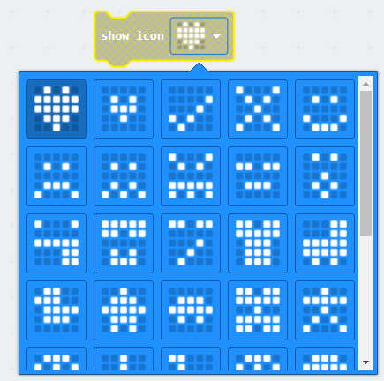
Challenge Rules
Include at least 3 melodies with a different icon displayed on the LED display for each melody
Must play each melody in order, and restart the first melody after the last one

Slide 9
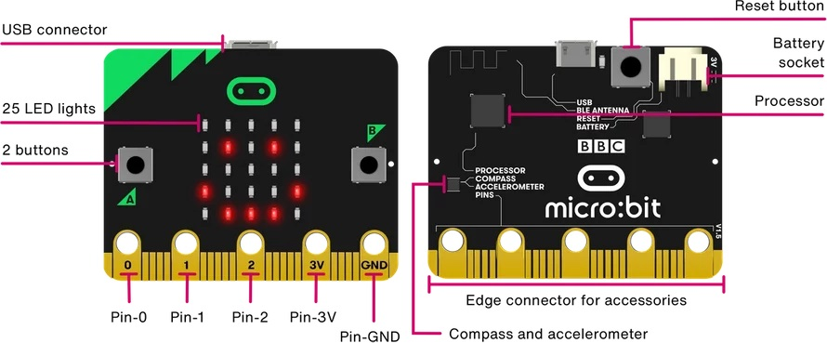
Challenge Rules
Must have at least two features using buttons (e.g. volume up/volume down, mute/unmute, next/previous, etc.)

Slide 10
Challenge Rules
If your code produces an error message on program start, you will automatically get a score of 0
If it produces an error message for only certain inputs, points will be deducted

Slide 11
Instruction Manual
How your music player works:
A diagram of what inputs on the Micro:Bit are linked with which features
Any additional information you deem necessary to understand how to operate your music player

Slide 12
Instruction Manual
No more than 1 page
It can either be typed up, or handwritten and scanned, as long as it is legible
Note: If it cannot be read, you will get a score of 0 for the section.

Slide 13
One Page Report
Introduce team
Team name, member names, school name
Micro:Bit
Project Name
Project Features
Challenges while coding and how they fixed them
Mini pitch
What makes your project unique and deserve to win?

Slide 14
Judging and Scoring
Quality of Code:
Visual organization of the code blocks, no code reuse, proper use of function/loops, proper naming of variables/functions, proper code comments
Creativity and originality
Include original melodies and LED icons and not just the preset melodies and icons

Slide 15
Judging and Scoring
All scoring will take grade level into consideration
The winner of the Challenge will be determined by the combined score of the:
Instruction manual
One page report
Required code features
Code quality
Creativity and originality
Degree of difficulty

Slide 16
Judging and Scoring
Bonus Points:
Include more than 2 button features
The melodies and LED displays are based on a theme that is described in the report
Decisions of the judges are final

Slide 17
What to submit
File | Format
Code | .hex
Instruction Manual (scanned or typed) | .pdf
One Page Report (typed) | .pdf

Slide 18
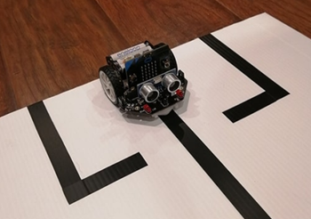
Wildlife Ambulance Challenge
Your task:
Program a robot to follow a line and stop when it encounters obstacles.

Slide 19
Challenge Rules
The standard Micro:Bit and DFRobot Maqueen Kit will be used by the judges to run your code.
Your robot must go through 3 different tracks, with varying levels of difficulty.
Your robot will have 3 attempts for each track, with a maximum of 2 minutes per attempt.

Slide 20
Challenge Rules
Your robot must follow the black line and stop in front of obstacles that appear along the way.
The obstacle will be removed when the robot has been stopped for 3 seconds.
If your robot runs into the obstacle or otherwise does not stop at the obstacle, a time penalty of 15 seconds will be given.

Slide 21
Challenge Rules
If both wheels of your robot leave the track for more than 10 seconds, the trial is finished.
An obstacle will be placed at the end of the track, the run will be over when your robot stops in front of it, or runs into it and incurs a time penalty.
Refer to the rules document for specifications on the tracks and obstacles.

Slide 22
One Page Report
Introduce team
Team name
Team member names
School, if applicable
Micro:Bit
Project Name
Challenges while coding and how they fixed them
The report will account for 10 points of your final evaluation.

Slide 23
Judging and Scoring
Each track will be scored out of 10 :
1 point for leaving the initial box
3 points for passing through the first obstacle
3 points for finishing the track
3 points for having the best time on a track
Quality of Code (10 Points):
Visual organization of the code blocks, no code reuse, proper use of function/loops, proper naming of variables/functions, proper code comments

Slide 24
Judging and Scoring
Total grading will be out of 50
30 Points for track completion
10 Points for Code Quality
10 Points for the One Page Report
Judges’ decisions are final.

Slide 25
What to submit
File | Format
Code | .hex
One Page Report (typed) | .pdf

Slide 26
How to submit your work
Fill out a form in the link provided: http://www.orc.ieeeottawa.ca/submission/

Slide 27
Due dates
Challenge due date:
10:59 pm Eastern Time on May 14th, 2022

Slide 28
Questions?

