Slide 1
19th Annual IEEE Ottawa Robotics Competition 19e Compétition annuelle de robotique d’Ottawa d’IEEE
Micro:Bit Challenge Workshop
February 20, 2021

Slide 2
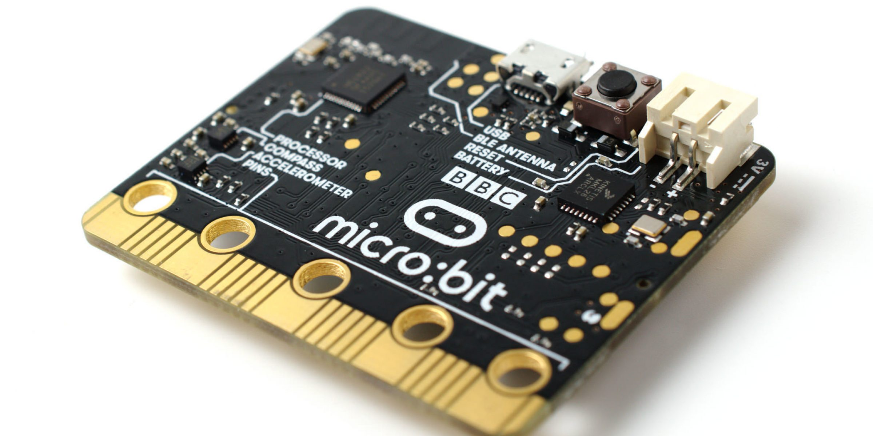
About Micro:bit
Microcontroller developed by the BBC
Designed to be easy and fun to program
Tutorials: https://microbit.org/
Documentation: https://makecode.microbit.org/docs

Slide 3
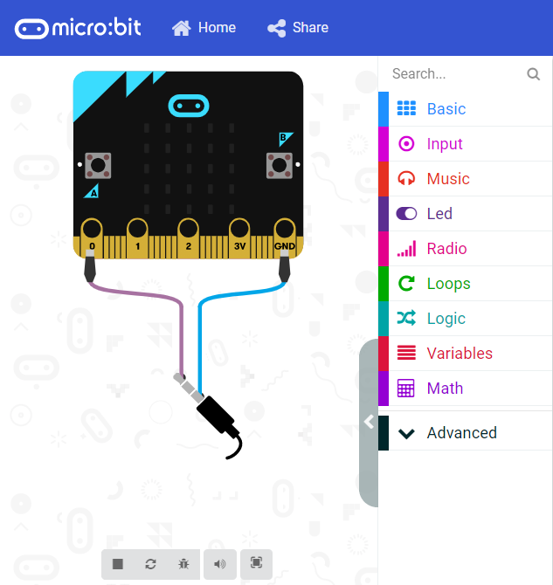
Micro:bit Simulator
Online
https://makecode.microbit.org/
Microsoft Store
https://www.microsoft.com/en-ca/p/makecode-for-micro-bit/9pjc7sv48lcx?activetab=pivot:overviewtab
iOS or Android in respective App Stores (only recommended on large tablets)
Notes:
Physical kit is optional
Only code will be submitted and tested on simulator

Slide 4
Programming
Coding is done here: https://makecode.microbit.org/
Can be programmed in blocks, javascript or python
Students can save the code (as backup) and import the code to other computers
Code can be downloaded straight to the micro:bit or drag and dropped onto it

Slide 5
Micro:bit Classroom
Online classroom environment
Can watch students code live
https://classroom.microbit.org/

Slide 6
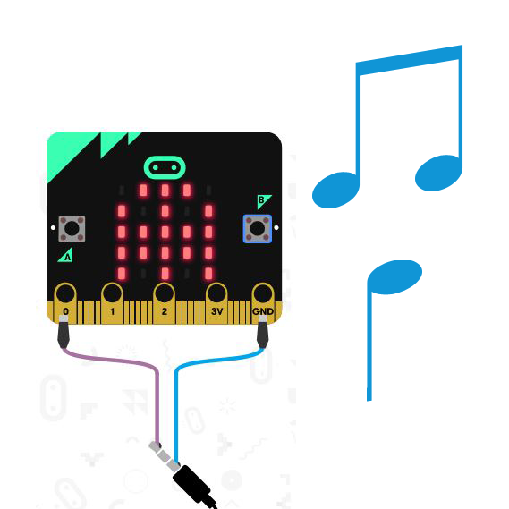
The Challenge
Your task:
Create a music player with songs and LED displays to help people stay entertained

Slide 7
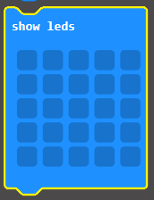
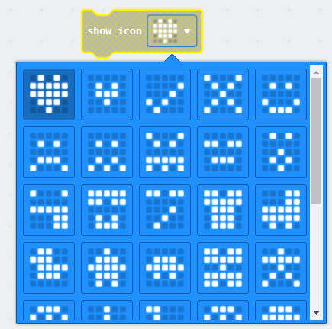
Challenge Rules
Include at least 3 melodies with a different icon displayed on the LED display for each melody
Must play each melody in order, and restart the first melody after the last one

Slide 8
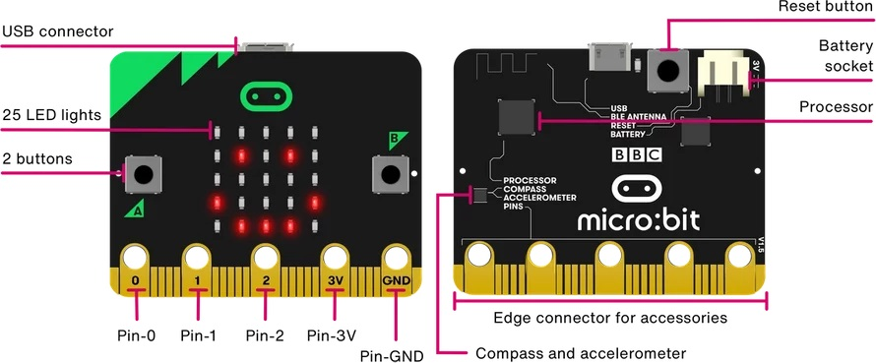
Challenge Rules
Must have at least two features using buttons (e.g. volume up/volume down, mute/unmute, next/previous, etc.)

Slide 9
Challenge Rules
If your code produces an error message on program start, you will automatically get a score of 0
If it produces an error message for only certain inputs, points will be deducted

Slide 10
Instruction Manual
How your music player works:
A diagram of what inputs on the Micro:Bit are linked with which features
Any additional information you deem necessary to understand how to operate your music player

Slide 11
Instruction Manual
No more than 1 page
It can either be typed up, or handwritten and scanned, as long as it is legible
Note: If it cannot be read, you will get a score of 0 for the section.

Slide 12
One Page Report
Introduce team
Team name
Team member names
School, if applicable
Micro:Bit
Project Name
Project Features
Challenges while coding and how they fixed them

Slide 13
One Page Report
Mini pitch
What makes your project unique and deserve to win?
The report will account for 30% of your final evaluation.

Slide 14
Judging and Scoring
Quality of Code:
Visual organization of the code blocks, no code reuse, proper use of function/loops, proper naming of variables/functions, proper code comments
Creativity and originality
Include original melodies and LED icons and not just the preset melodies and icons

Slide 15
Judging and Scoring
All scoring will take grade level into consideration
The winner of the Challenge will be determined by the combined score of the:
Instruction manual
One page report
Required code features
Code quality
Creativity and originality
Degree of difficulty

Slide 16
Judging and Scoring
Bonus Points:
Include more than 2 button features
The melodies and LED displays are based on a theme that is described in the report
Decisions of the judges are final

Slide 17
What to submit
File | Format
Code | .hex
Instruction Manual (scanned or typed) | .pdf
One Page Report (typed) | .pdf

Slide 18
How to submit your work
Fill out a form in the link provided: http://www.orc.ieeeottawa.ca/submission/

Slide 19
Due dates
Challenge due date:
10:59 pm Eastern Time on May 14th, 2021

Slide 20
Questions?

